Slide 1
Modeling Bacterial Lag Phase
Chen Liao, MSK

Slide 2
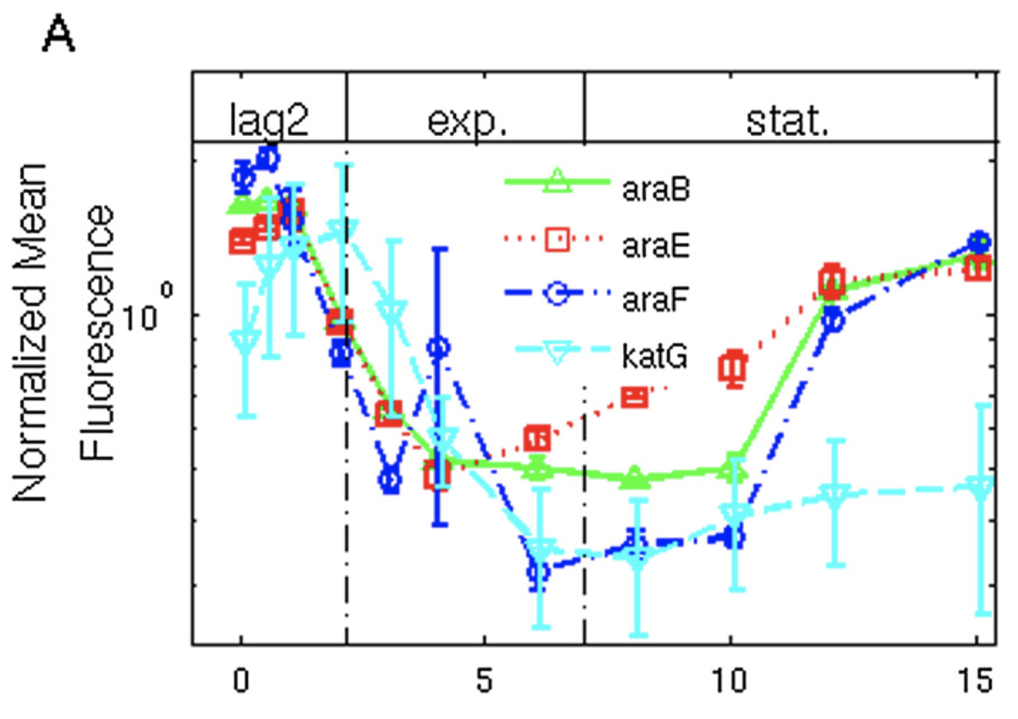
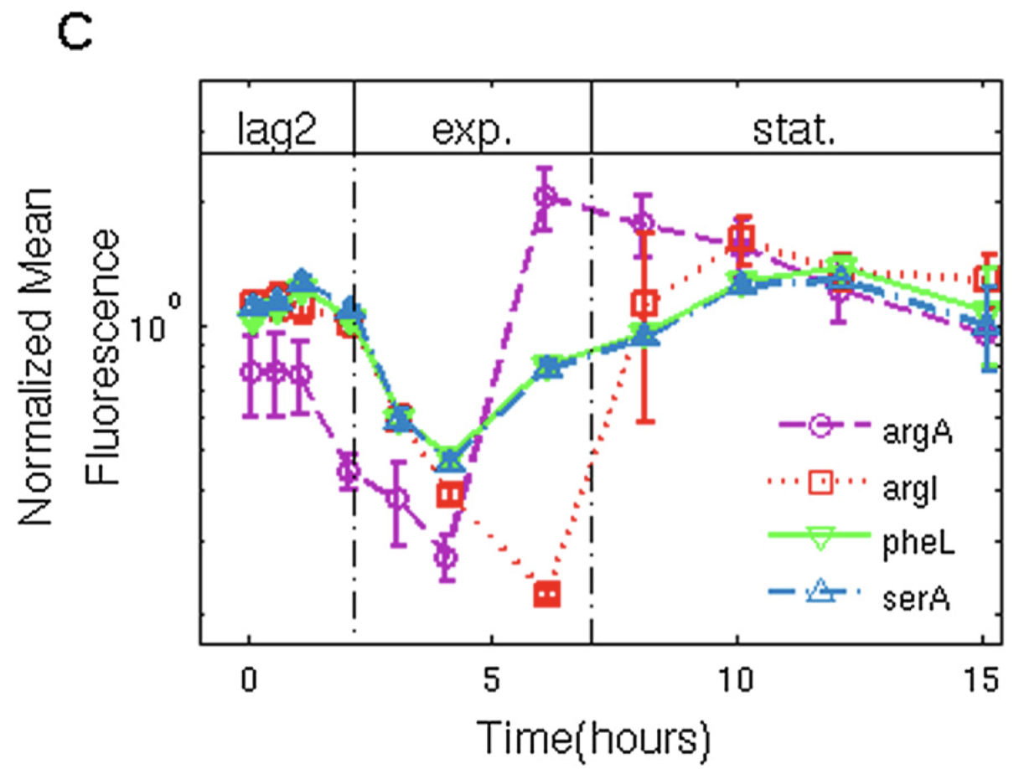
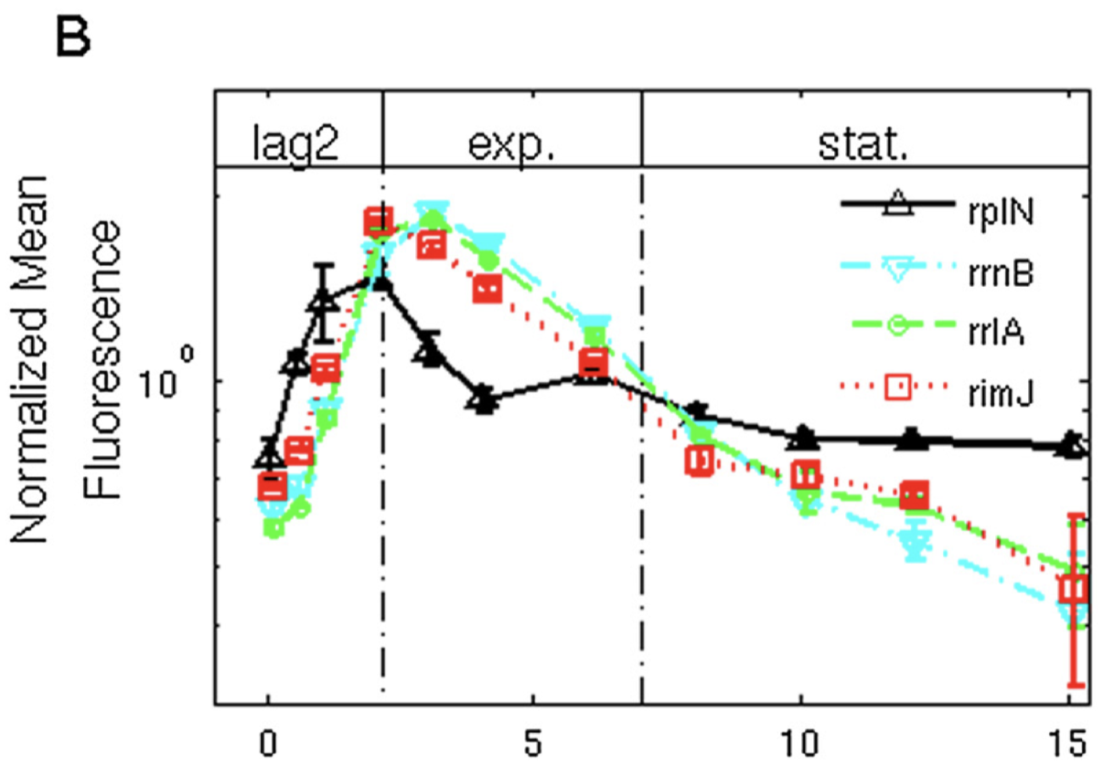

What do bacteria do in Lag Phase?
Arabinose promoters and catalase
Amino acid synthetic genes
rRNA and r-protein synthetic operon

Slide 3
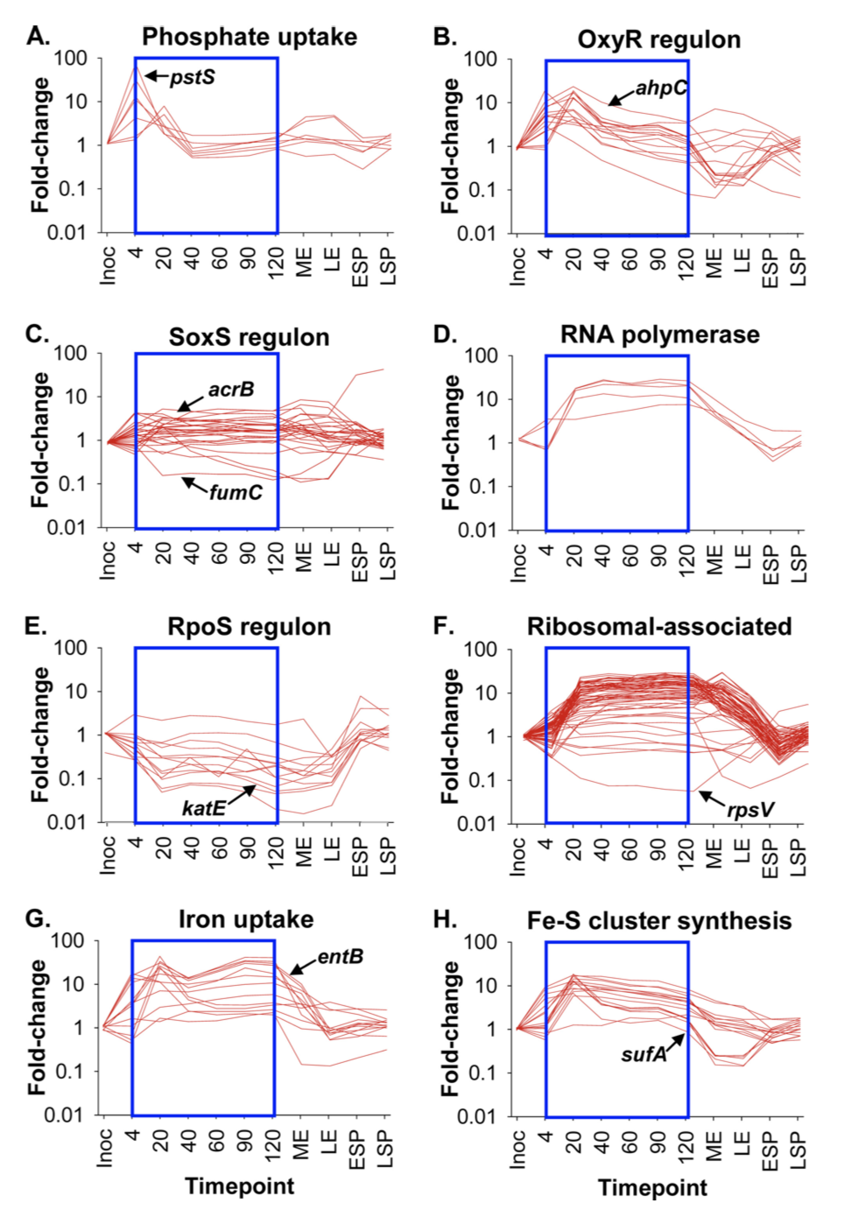
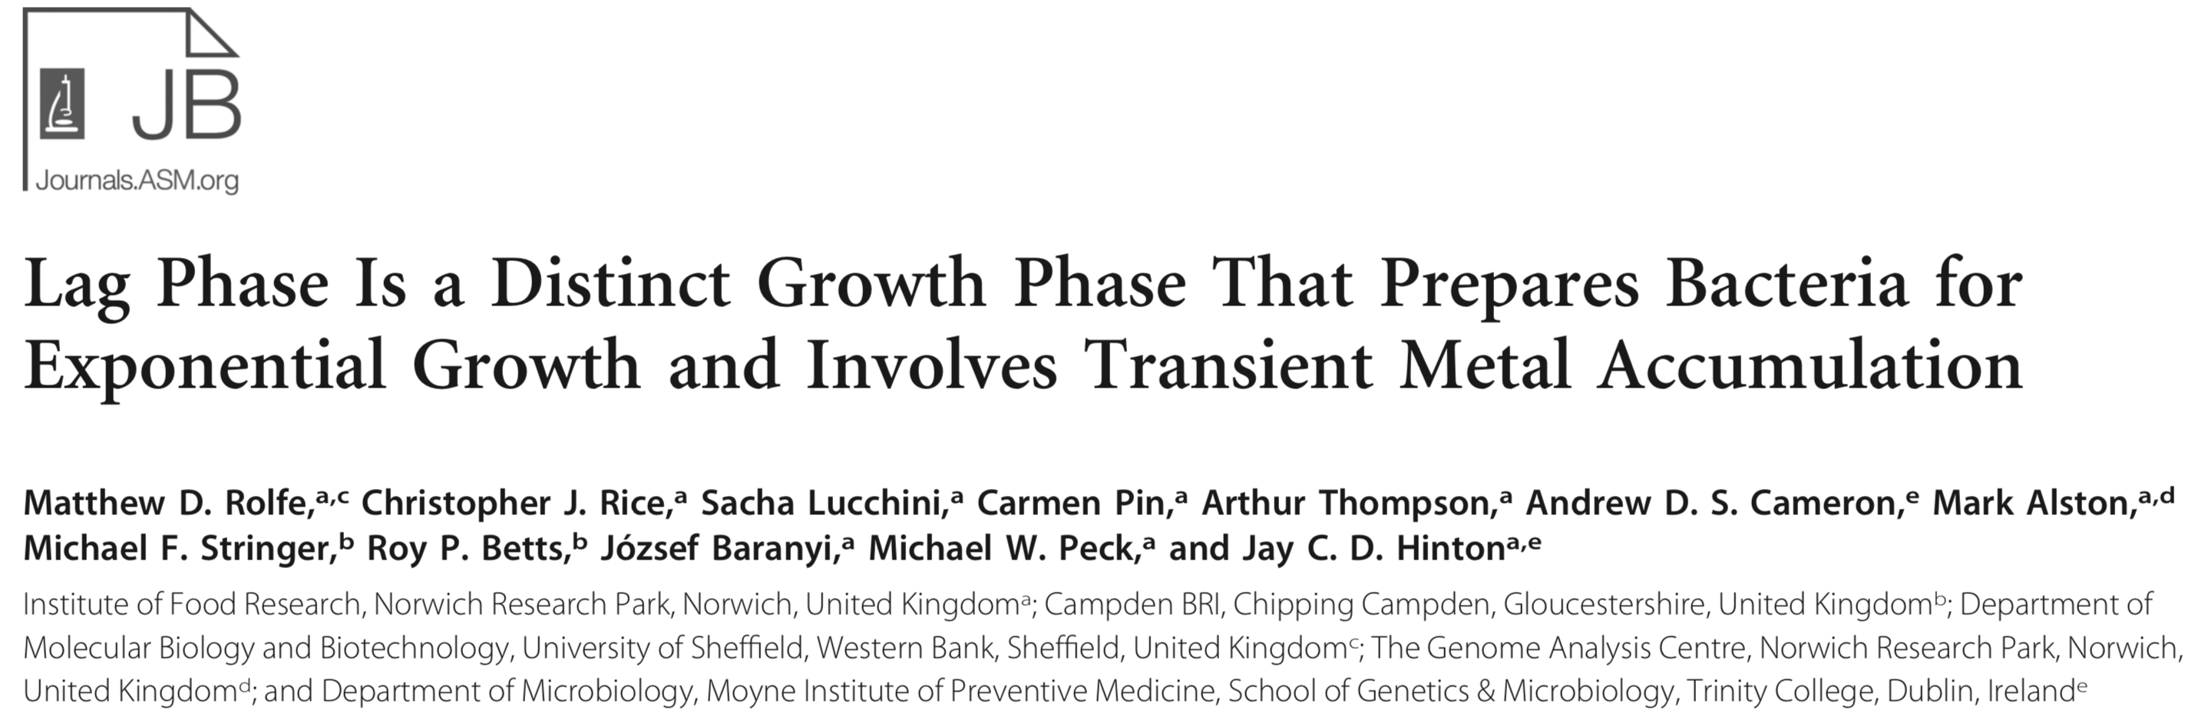
What do bacteria do in Lag Phase?

Slide 4
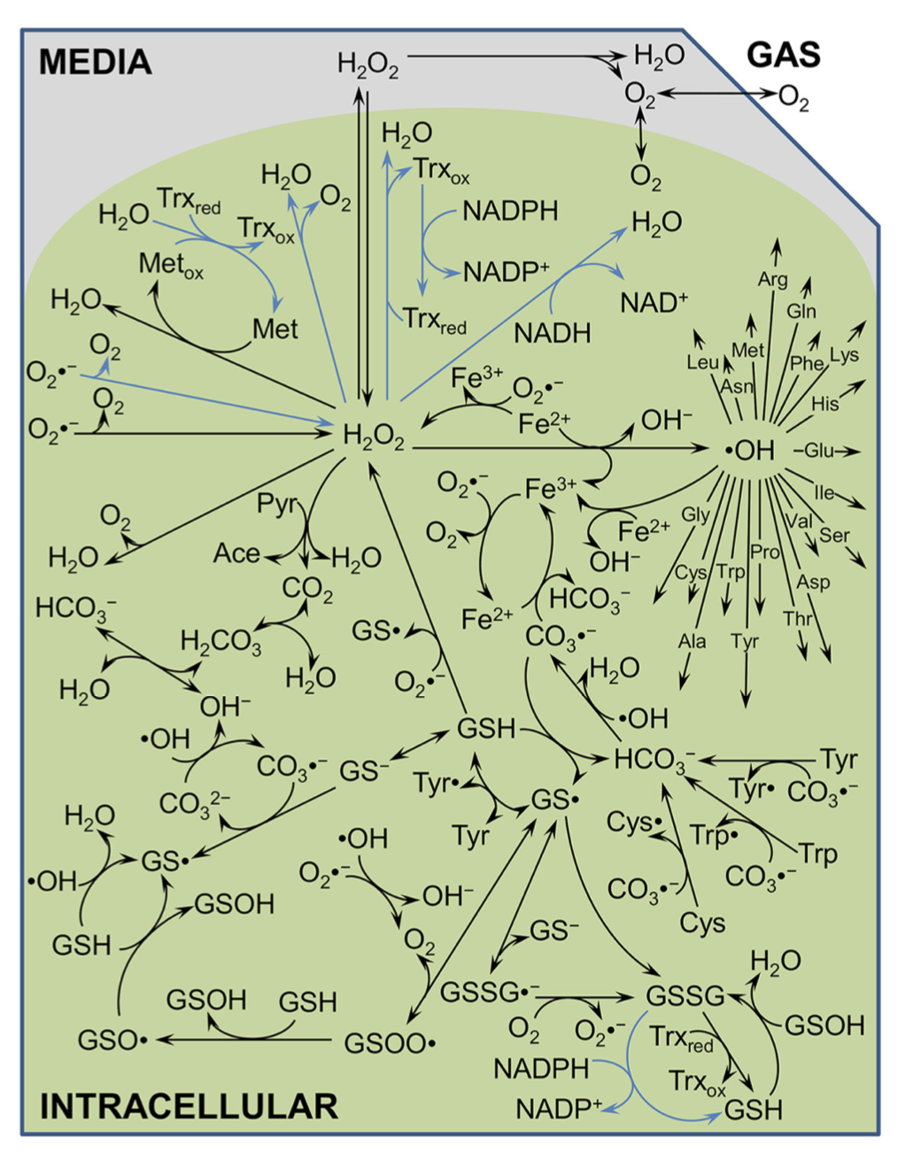
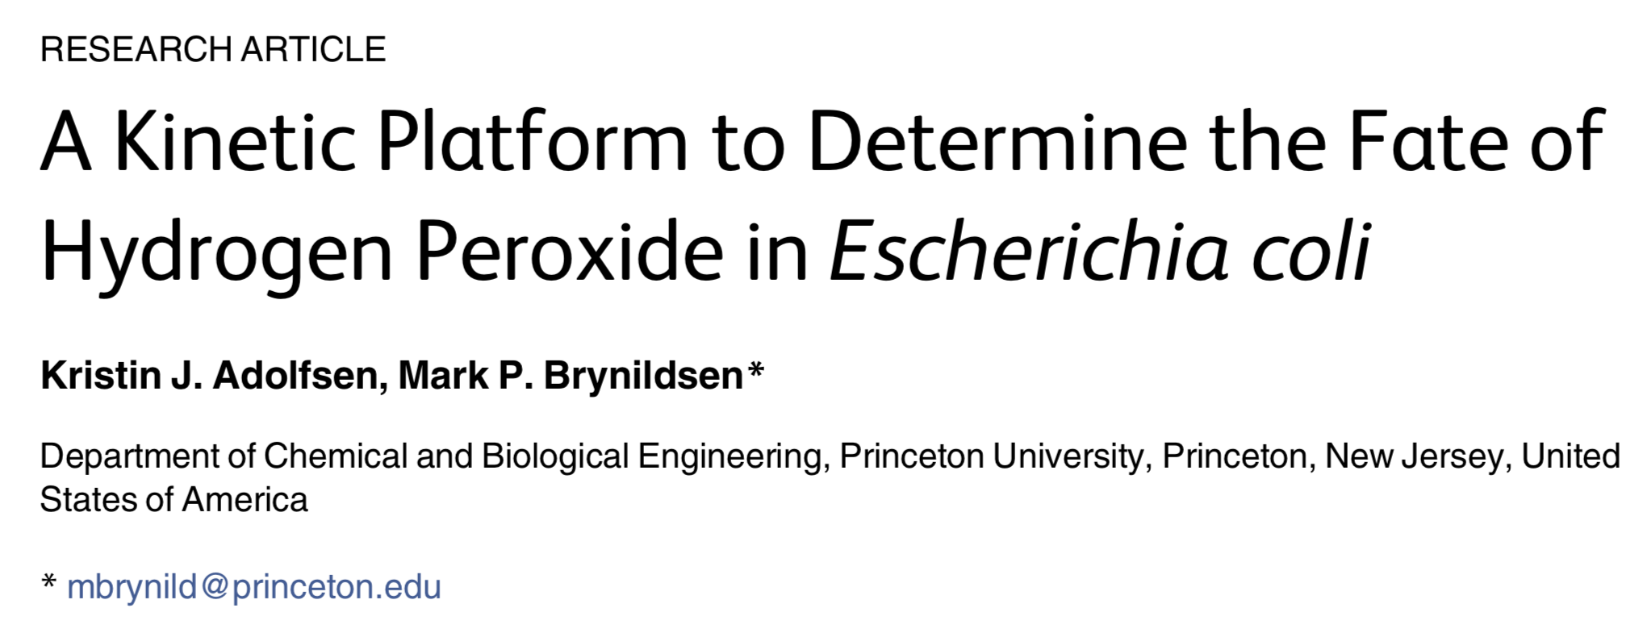
Modeling H₂O₂ Production/Consumption

Slide 5
Major challenge: None of the H₂O₂ models I have seen have coupled bacterial growth and H2o2 network to describe bacterial growth, particularly lag phase.

Slide 6
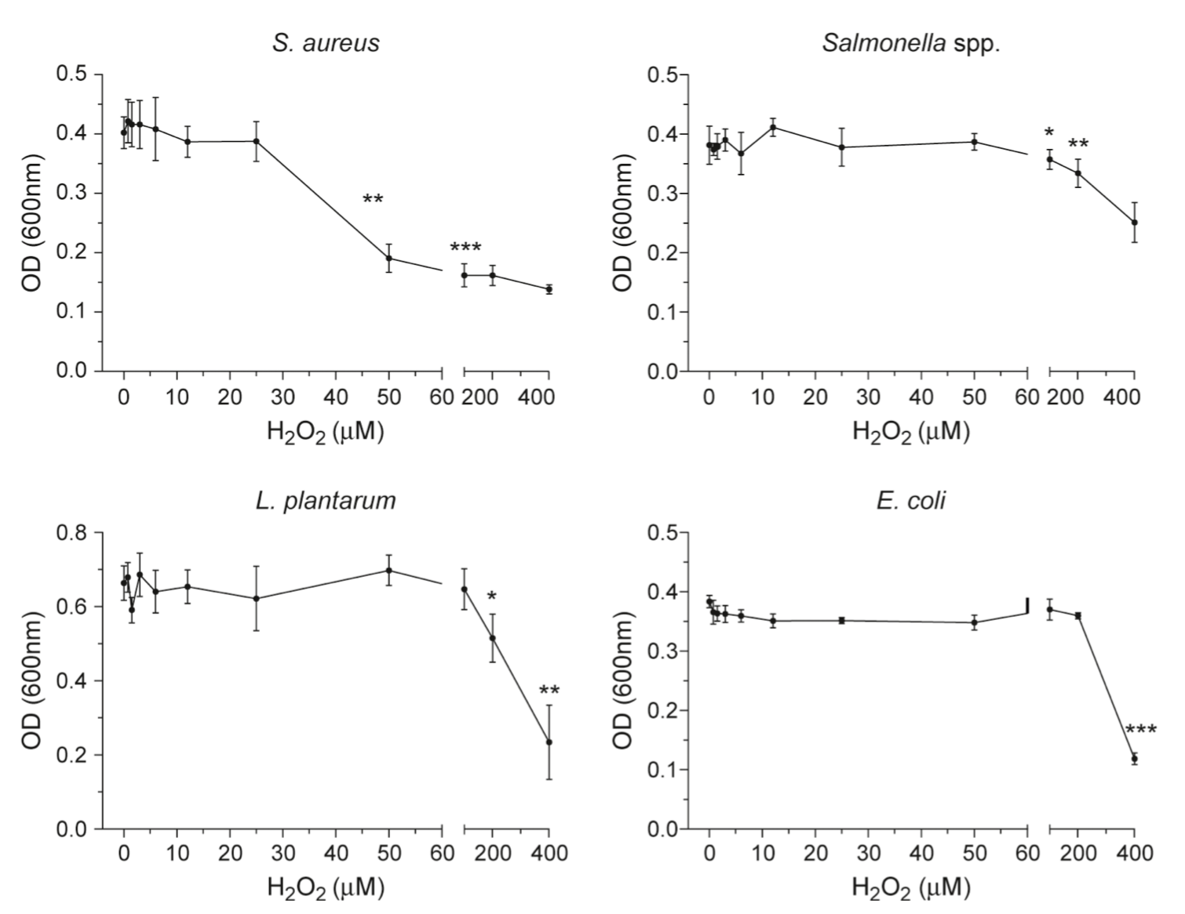
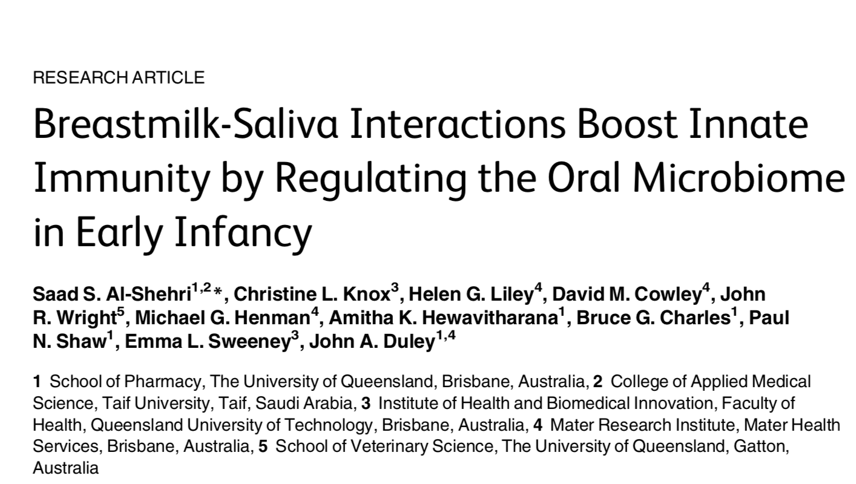
Bacterial tolerance to H₂O₂
Hydrogen peroxide was added to nutrient broth inoculated with bacteria and incubated for 24 h at 37°C, except for L. plantarum, which was incubated for 48 h

Slide 7
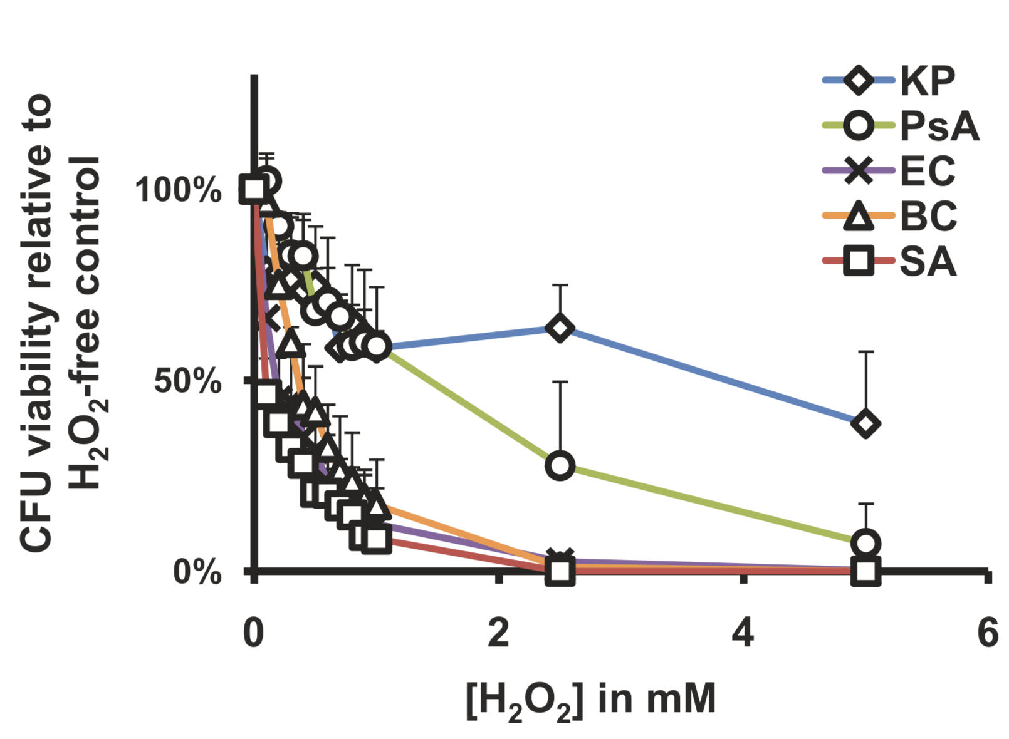
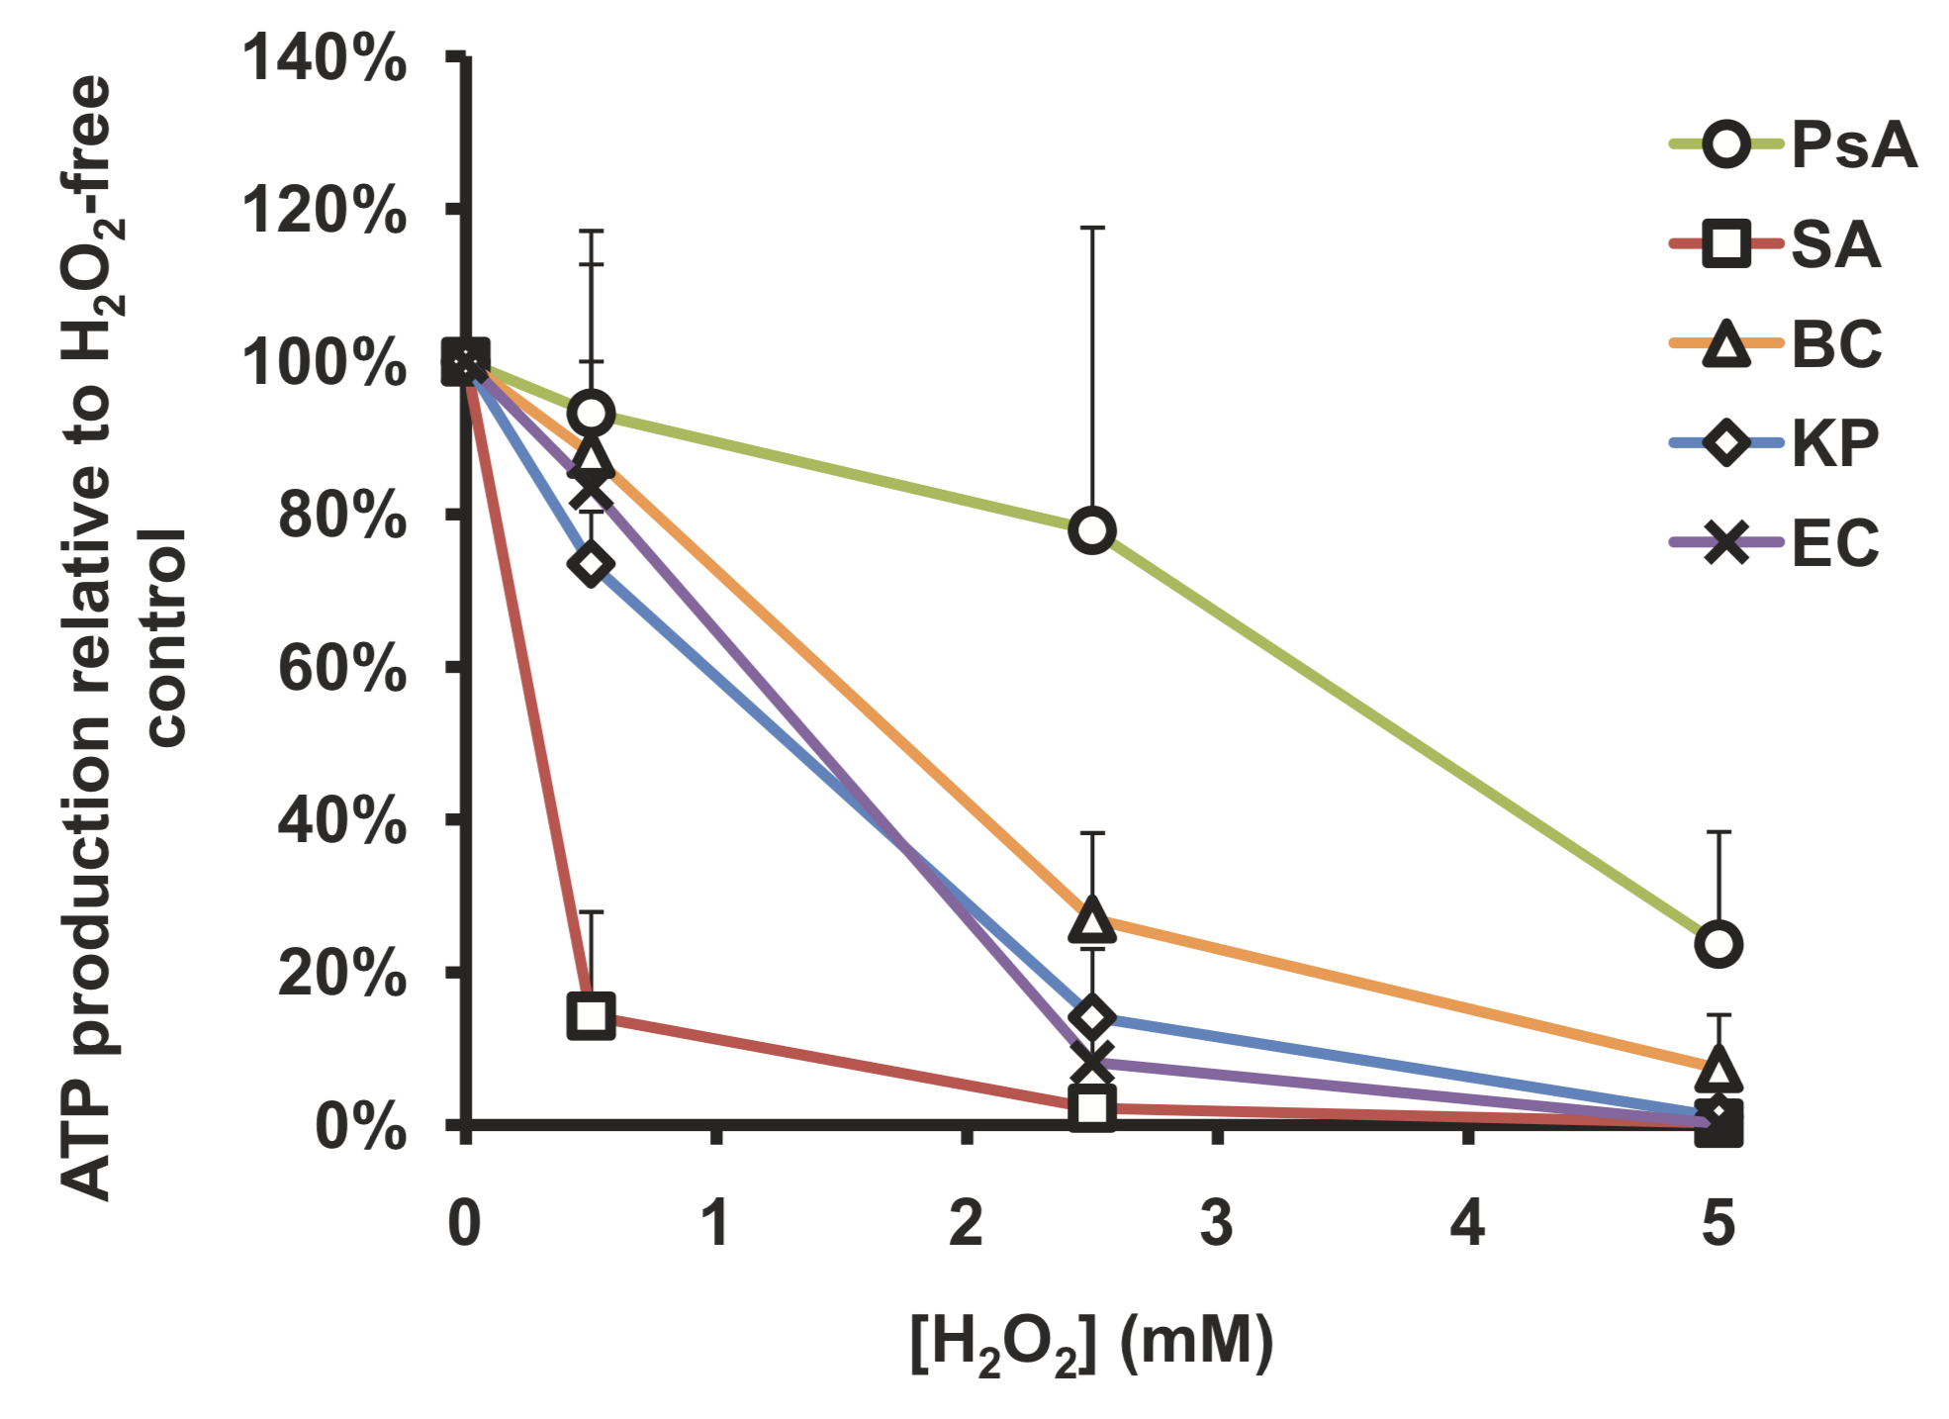
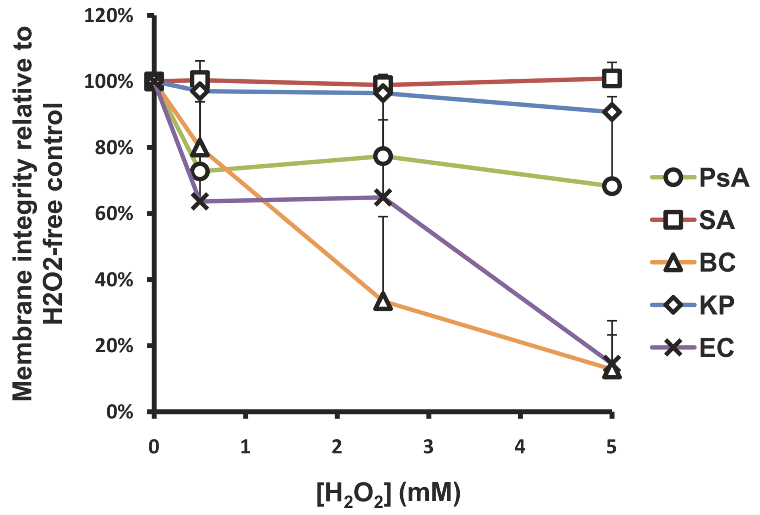
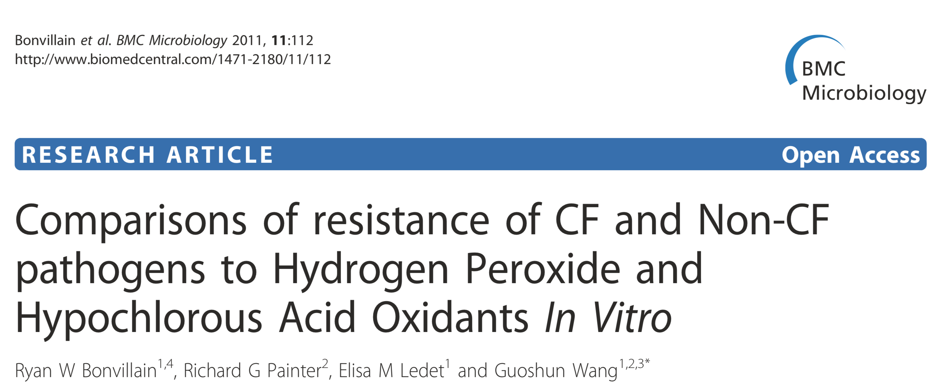
Bacterial tolerance to H₂O₂

Slide 8
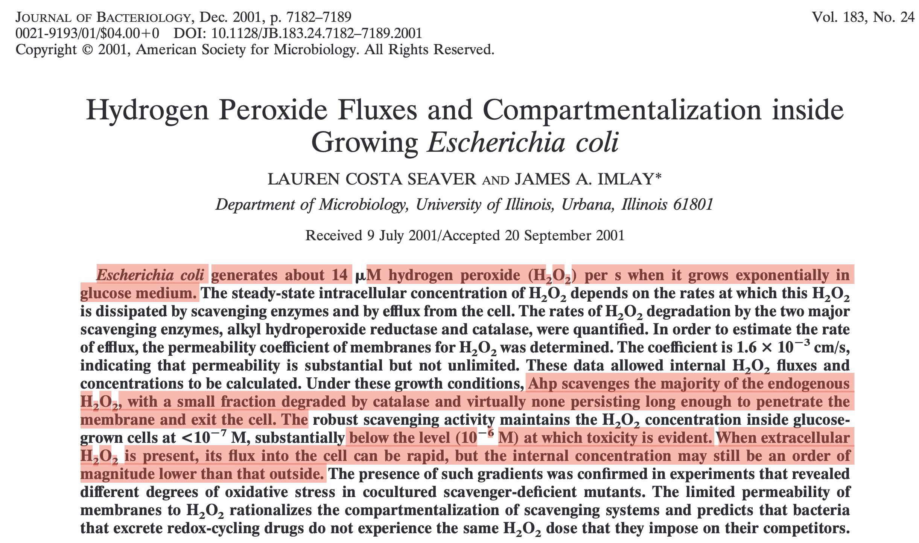

Slide 9
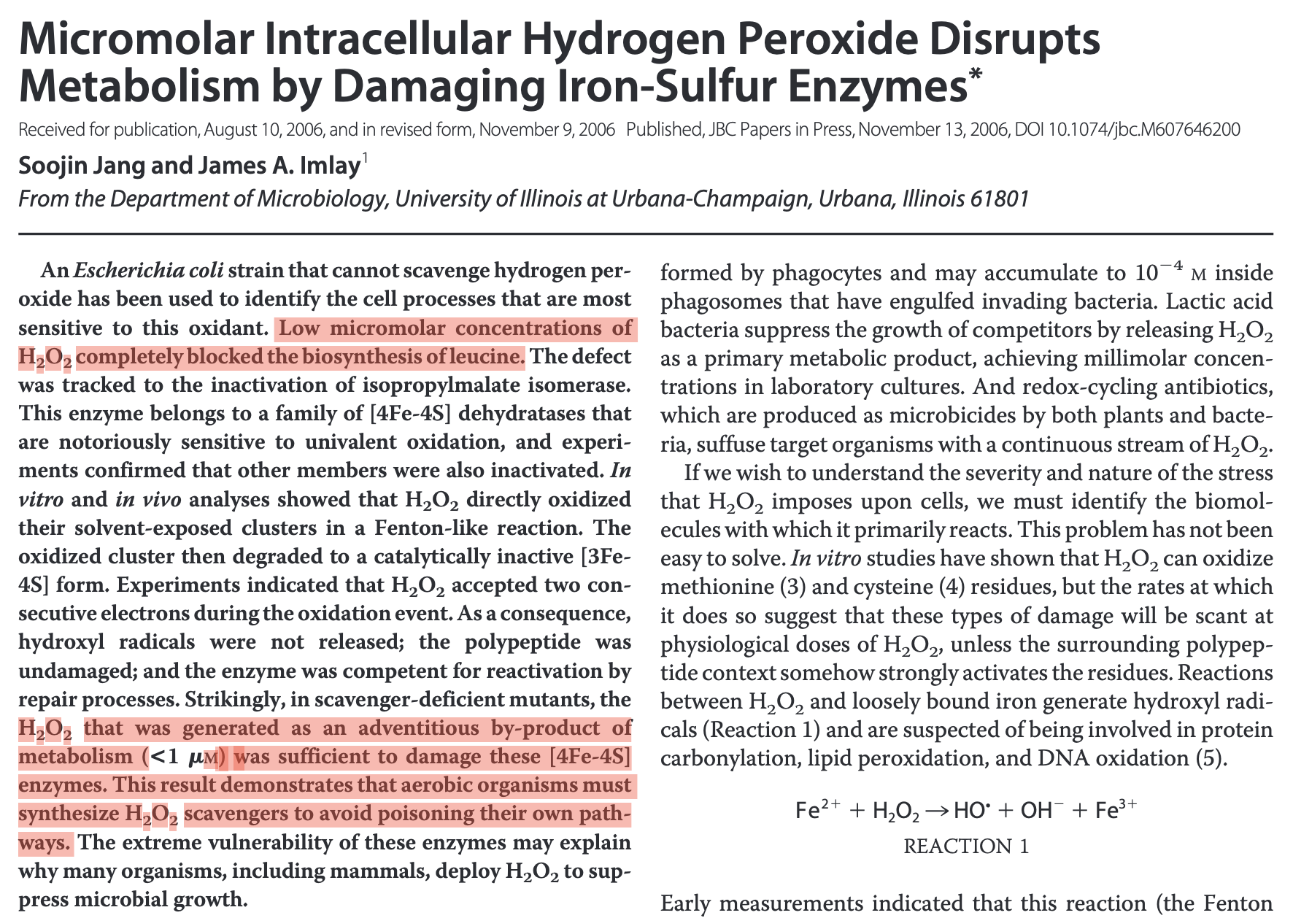

Slide 10
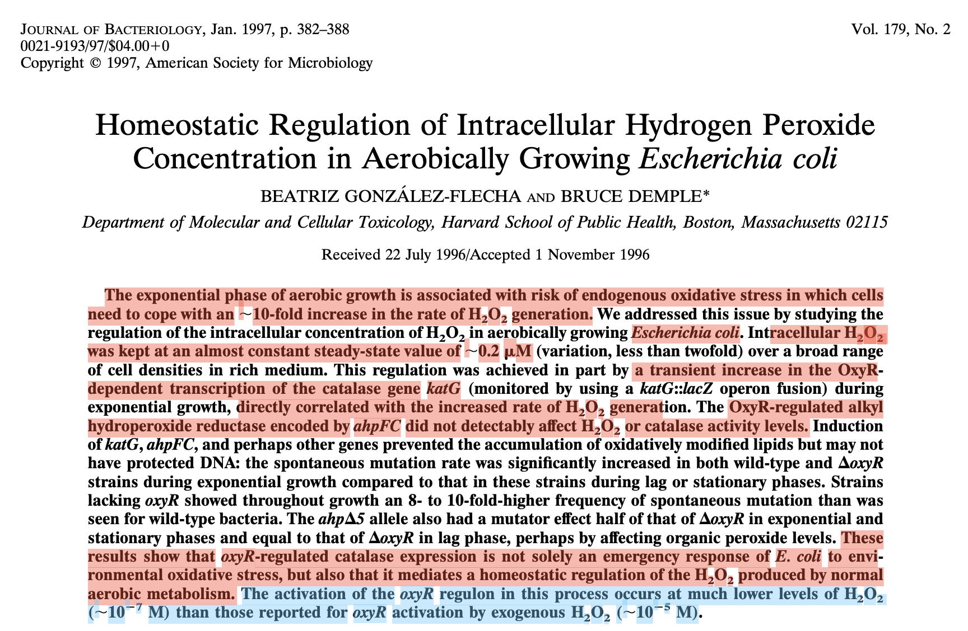

Slide 11
Basic Model: No Proteome Partition

Slide 12
Proteome Partitioning Model

Slide 13
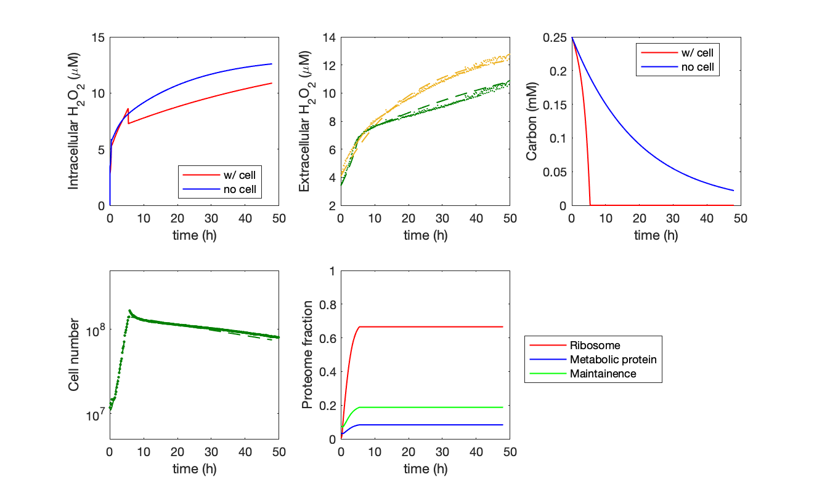
Fit Growth and H₂O₂ Production in Glucose Medium

Slide 14
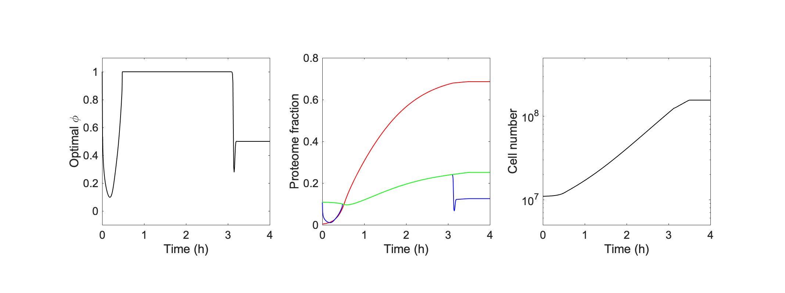
Optimal Solution for Maximizing Biomass

